Slide 1
CSI2300-Final Project
Team Name: OrangeCatEnergy
Members: Devin M

Slide 2
Introducing your application scenario and problem statement
Application Scenario
Someone who has multiple responsibilities and often loses track of them can put in they’re goals and even attach minor goals to keep track of what has to be completed
Problem Statement
People often struggle to keep track of progress on goals. Losing track of progress on certain goals can lead to missed deadlines or inefficient task management. This app aims to provide users with a way to organize their goals by a main goal and side goals which will allow them to create checkpoints on their way to completing the main goal

Slide 3
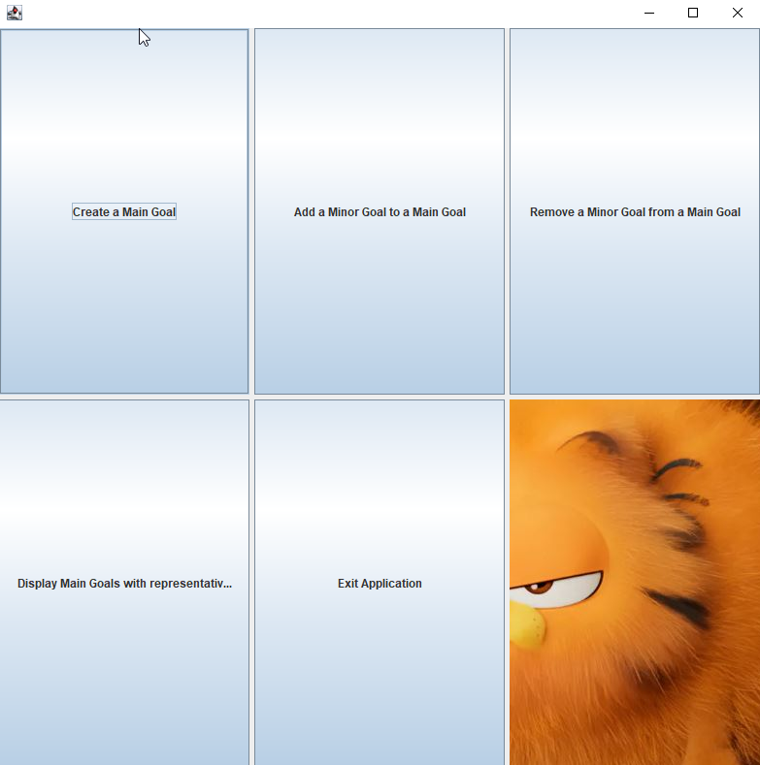
Purpose of this Application
Allow the user to create a main goal
Add minor goals to the main goal
Minor goals can have a description
They can have a importance level
Remove minor goals
View goals and check them off

Slide 4
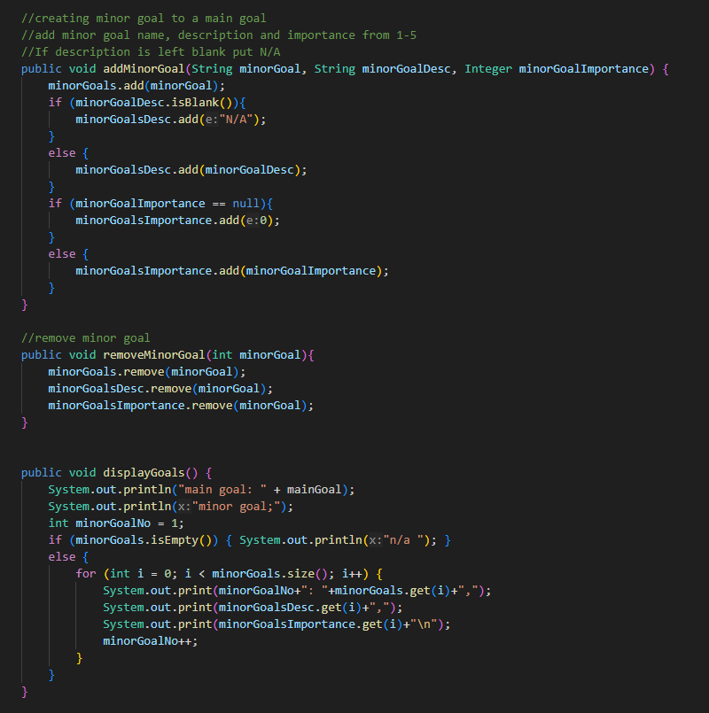
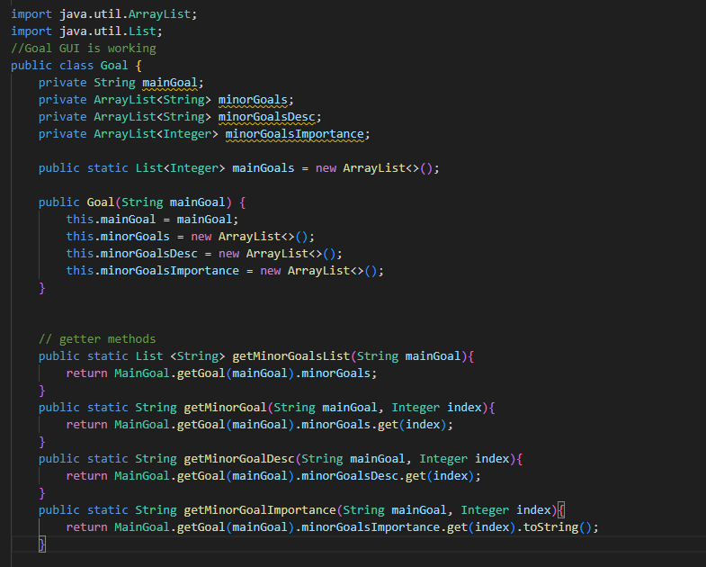
Goal.java

Slide 5
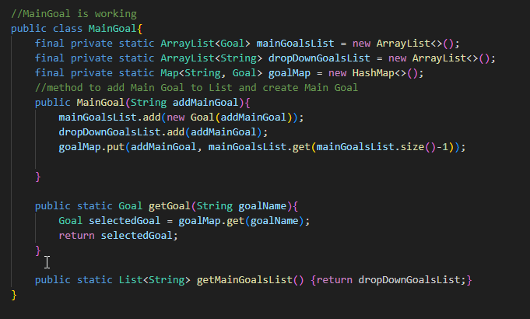
MainGoal.java

Slide 6
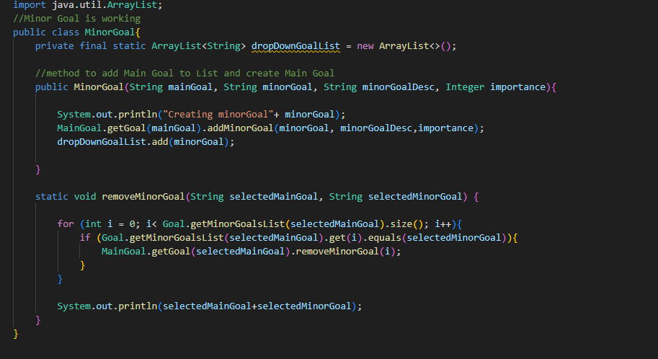
MinorGoal.java

Slide 7
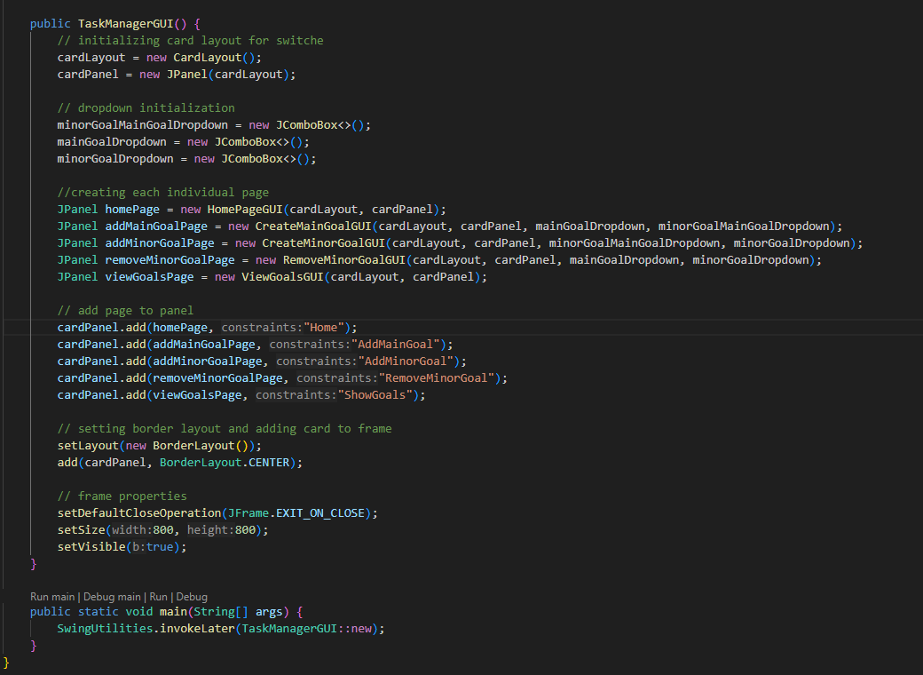
TaskManagerGUI.java

Slide 8
What I have learned/improved in from this project
Creating GUIs with Swing
How to split up the GUI portion into multiple files
How important it is to keep files as small as possible – makes understanding of code easier
HashMaps
Better understanding methods and constructors

Slide 9
Problems I ran into
JavaFX – made it hard to troubleshoot code – switched to swing
Swing dropdown menu to select goals – had to get the list with goals and repopulate dropdown each time there was a change
Converting String Goal to Goal Goal – solution was HashMap
GUI file being way too long and hard to navigate through
When splitting up the GUI code file I ran into visual problems when running the program

